Slide 1

Olist E-Commerce Diagnostic & Predictive Analytics
DASC4300 Capstone Project
Student Name: Tam Wing Ching · ID: 21007532

Slide 2
Project Scope & Methodology
Problem Statement
Solution Approach
Objective
Olist faces low retention despite high acquisition.
A data-driven pipeline: Segmenting high-risk customers, uncovering pain points in feedback, and forecasting demand patterns
Transform Olist from transactional to customer-centric.

Slide 3

Predictive & Diagnostic Analysis
Behavioral Segmentation
Feedback Diagnostics
Targeting high-churn risks using RFM-based K-Means clustering.
Extracting pain points from 1-star reviews via NLP topic modeling.
Trend Forecasting
Predicting future demand patterns using SARIMAX methodologies

Slide 4
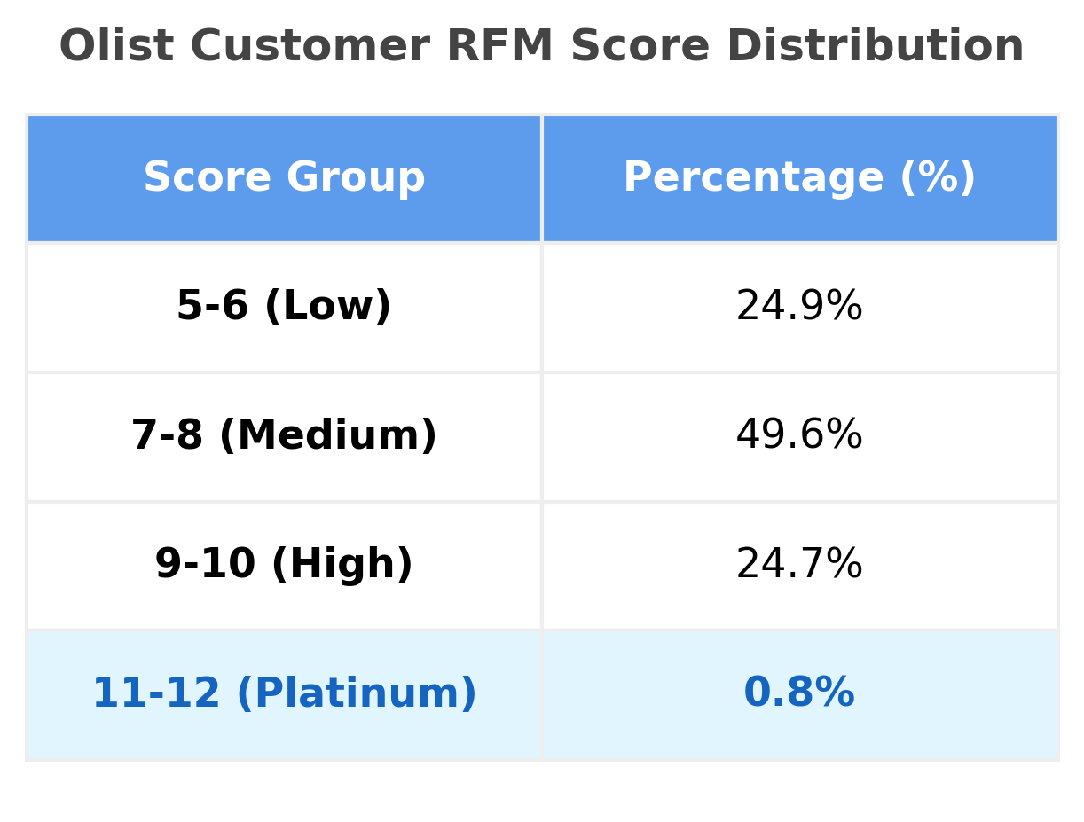
DIAGNOSTIC ANALYSIS
RFM Customer Segmentation
Strategic Diagnosis
A critically low Platinum retention rate of 0.8% prompted deployment of RFM modeling to diagnose customer loyalty patterns and quantify churn risk across the full buyer base.
Scoring Methodology
Raw transaction data was standardized into a 1–4 scale using statistical quartiles. Recency was scored inversely — rewarding recent activity — to surface the most engaged, highest-value customers.
*Note: RFM scores of 3-4 were not observed in this dataset

Slide 5
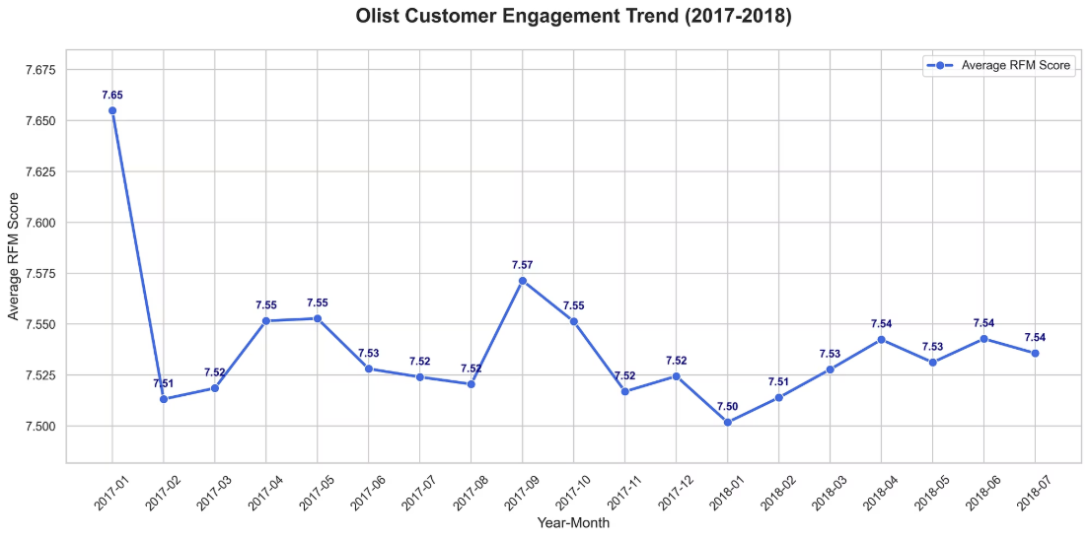

ENGAGEMENT TREND
Customer Engagement & Quality Trend
Stable Acquisition Quality
Across 18+ months, the Average RFM Score held remarkably steady between 7.50 and 7.57 — demonstrating that Olist successfully scaled order volume without diluting customer quality.
Consistent RFM scores during rapid growth signal disciplined acquisition and a healthy underlying customer base.

Slide 6
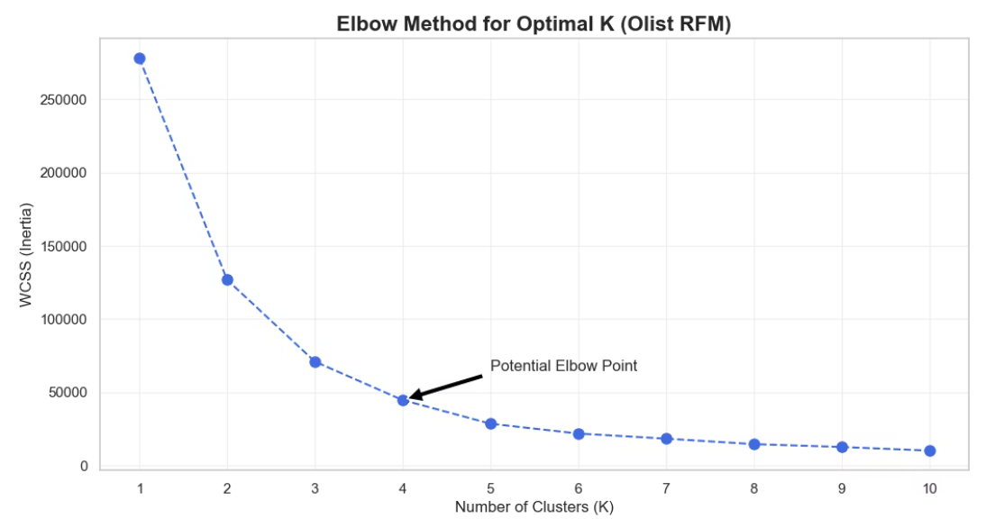
ADVANCED SEGMENTATION
K-Means Clustering: Methodology
Robust Preprocessing
Log Transformation was applied to mitigate monetary skewness, while Standardization harmonized disparate RFM scales — ensuring unbiased distance calculations for the K-Means algorithm.
Optimal Cluster Selection
The Elbow Method identified K=4 as optimal, achieving the best trade-off between model complexity and within-cluster sum of squares (WCSS) reduction.

Slide 7

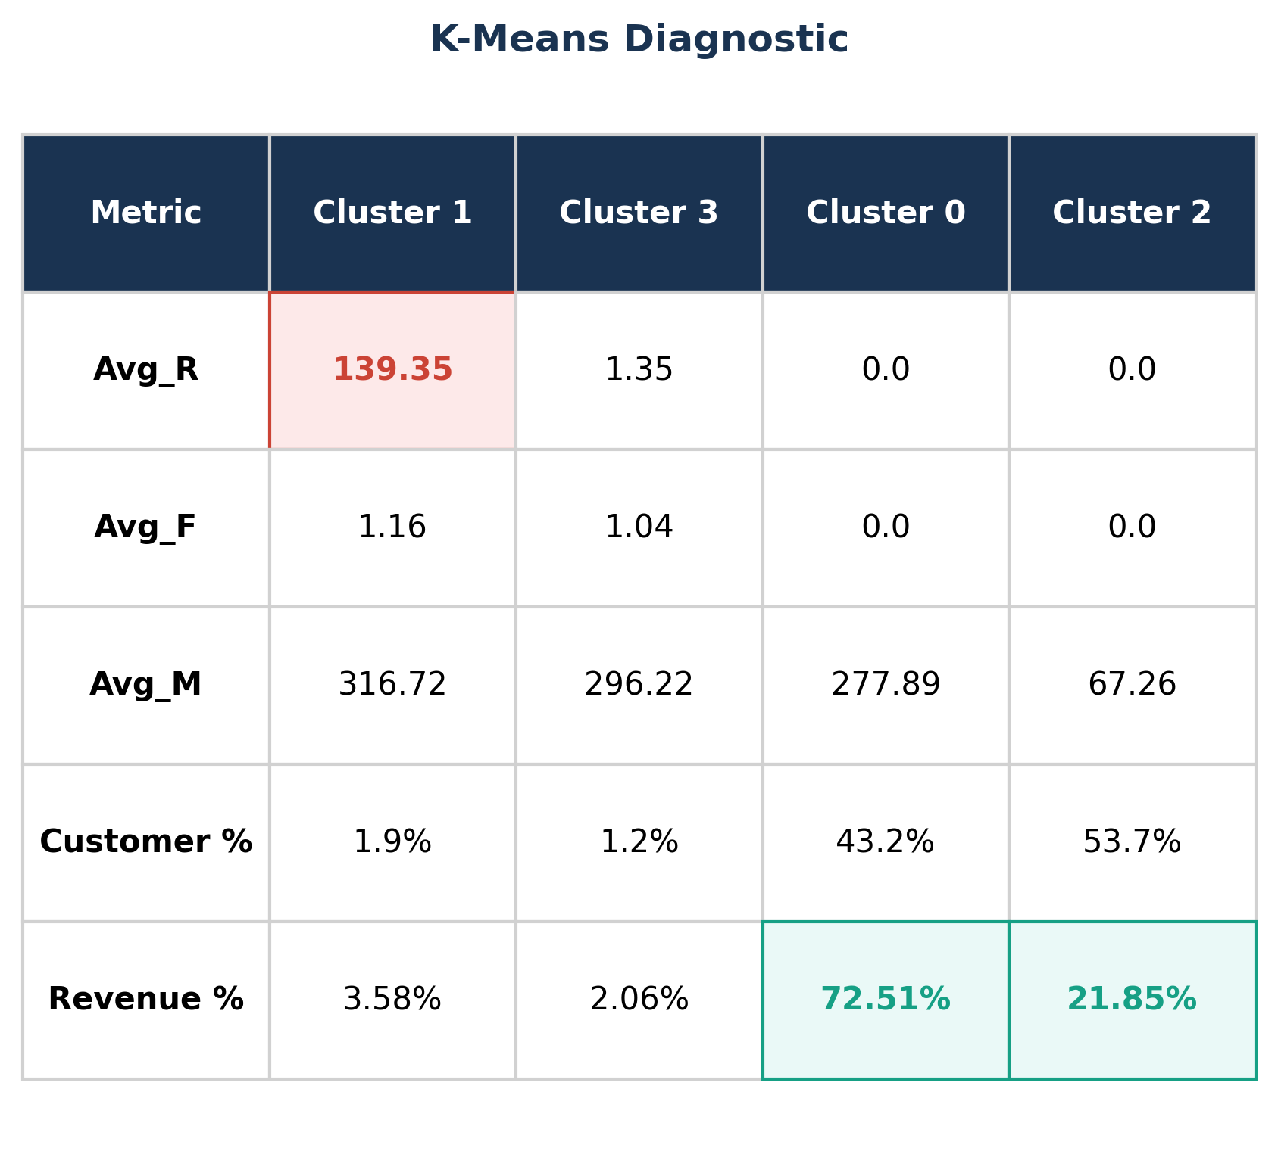
KEY FINDING
The "Leaky Bucket" Phenomenon
New-Customer Dependence
Growth relies on continuous acquisition rather than repeat purchase — a structurally unsustainable model.
The Loyalty Paradox
High-value spenders (Cluster 1) are not being retained, creating a revenue leak that offsets acquisition gains.
Strategic Priority
Fixing the post-purchase experience for Cluster 1 high-spenders is the fastest path to transforming transactional cycles into a sustainable loyalty ecosystem.

Slide 8

DIAGNOSTIC SOLUTIONS
Strategic Recommendations: Retention Interventions
Automated Win-Back System (Recency based)
New User Program (Clusters 0 & 2)
Introductory incentives and welcome bonuses
Goal: Convert new customers into repeat buyers
Stable Core Program (Cluster 3)
Exclusive retention programs and loyalty benefits
Goal: Maintain high-value customer engagement
Platinum Tier Program (Top 0.8%)
Premium benefits: free shipping, priority support
Goal: Stabilize most profitable segment and maximize lifetime value

Slide 9

NLP Sentiment Analysis
Processing 1-star reviews to uncover root causes of dissatisfaction with a complete workflow
Text Preprocessing
Remove URL, punctuation, numbers, nonsensical text. Convert emoticon to text, remove stop words, freq, rare words, stem word, lemmatize word.
Neural Translation
NLLB-200 (Facebook) converting Portuguese to English.
Quality Audit
LaBSE evaluation: Score 0.657 (Semantic Similarity).
Topic Discovery
BERTopic on 9,869 1-star reviews distilled to 4 Critical Themes (5,619 reviews).
Advanced Refinement
CountVectorizer for phrase capture KeyBERTInspired for topic refinement

Slide 10




ROOT CAUSE DIAGNOSIS
4 Customer Pain Points Identified
Topic
Key Terms
Representative Feedback
Fulfillment & Returns
return, receive, cancel…
"I bought two products, only received one… still got no response."
Customer Anxiety
still waiting, am waiting…
"I'm still waiting for you. Still waiting for you."
Product Specification
meter, height, centimeter…
"The ad says height is about a centimeter but you receive less."
Installation Issues
installation, operation, manual…
"It is only possible to install without manual… necessary to contact manufacturer."

Slide 11
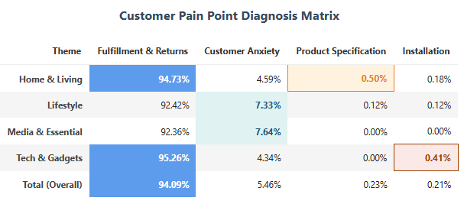
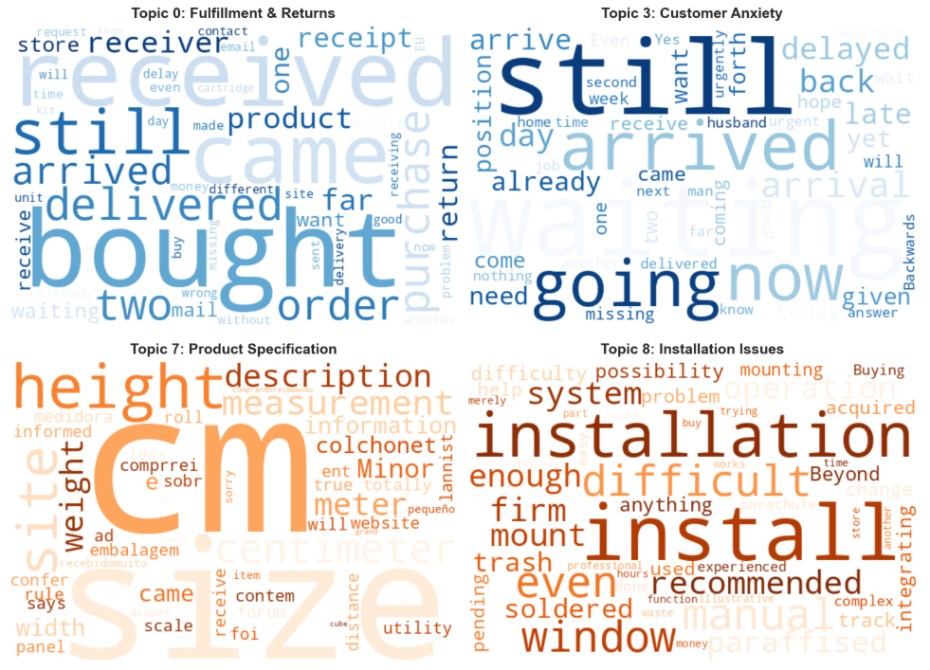
STRATEGIC BREAKDOWN
Category-Level Pain Point Distribution
94% of all complaints are tied directly to Fulfillment and Returns
Home & Living
Tech & Gadgets
Product Specification Discrepancies
Installation Issues (poor manuals)
Media & Essentials
Lifestyle
Customer Anxiety (poor tracking)
Customer Anxiety (poor tracking)
Strategic Insight: Fulfillment failures are physical delivery problems, while Customer Anxiety is a communication failure. Each requires targeted interventions.

Slide 12
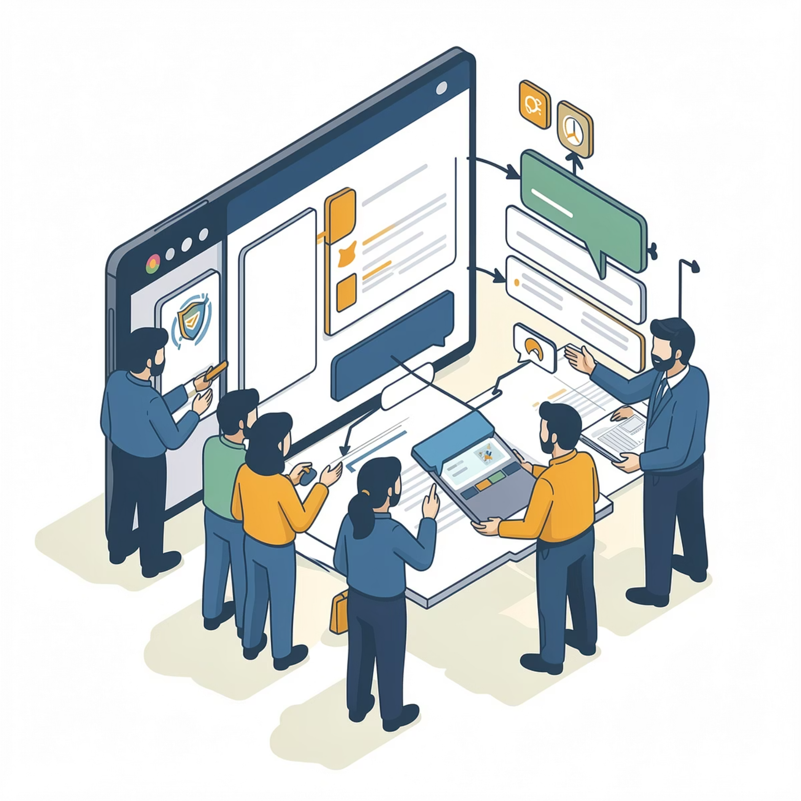
STRATEGIC INTERVENTIONS
NLP Solutions: Addressing Root Causes
Proactive Logistics & Dispute Management
Product Integrity & Information Standards
Address both "Action" problems and "Psychological" problems
Address Specification and Installation issues
Implement Live Customer Service to mediate disputes in real-time
Actively monitor orders with extreme lead times, impose strict penalties on underperforming sellers
Audit product specifications to eliminate fraud and ensure platform integrity
Implement Mandatory Digital Documentation standard, require sellers to upload instructional videos or enhanced digital manuals
Result: Significantly reduce Customer Anxiety
Result: Reduce avoidable returns and improve post-purchase experience

Slide 13
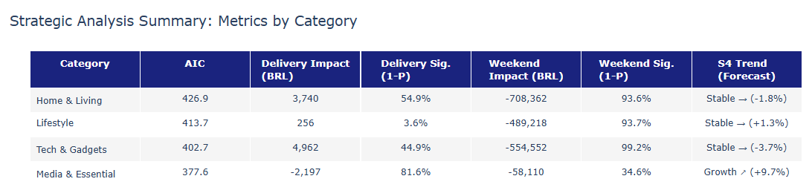


PREDICTIVE ANALYSIS
SARIMAX Forecasting 1: AIC
Seasonal forecasting with exogenous variables (weekend ratio, delivery days)
Training data (Jan 2017 – Aug 2018)
Forecast Period: Sep 2018 & (S4 Trend)
Home & Living: The highest AIC indicates complexity and volatility, unpredictability reflects fulfillment failures and product specification discrepancies.
Media & Essentials: The Lowest AIC score(377.6) indicates the most statistically reliable forecast

Slide 14
PREDICTIVE ANALYSIS
SARIMAX Forecasting 2: External Drivers
Seasonal forecasting with exogenous variables (weekend ratio, delivery days)
Training data (Jan 2017 – Aug 2018)
Forecast Period: Sep 2018 & (S4 Trend)
Other Categories: Purchasing is concentrated on weekdays.
Media & Essentials: Demand remains consistent throughout the entire week, with sales heavily influenced by delivery speed.

Slide 15
PREDICTIVE ANALYSIS
SARIMAX Forecasting 3: Trend
Seasonal forecasting with exogenous variables (weekend ratio, delivery days)
Training data (Jan 2017 – Aug 2018)
Forecast Period: Sep 2018 & (S4 Trend)
Declining Categories: Tech & Gadgets most significant drop at 3.7%, Home & Living: Expected to decline by 1.8%.
Growth & Resilience Categories: Media & Essentials show a standout performer with a projected 9.7% increase. Lifestyle maintaining steady momentum at 1.3%.

Slide 16
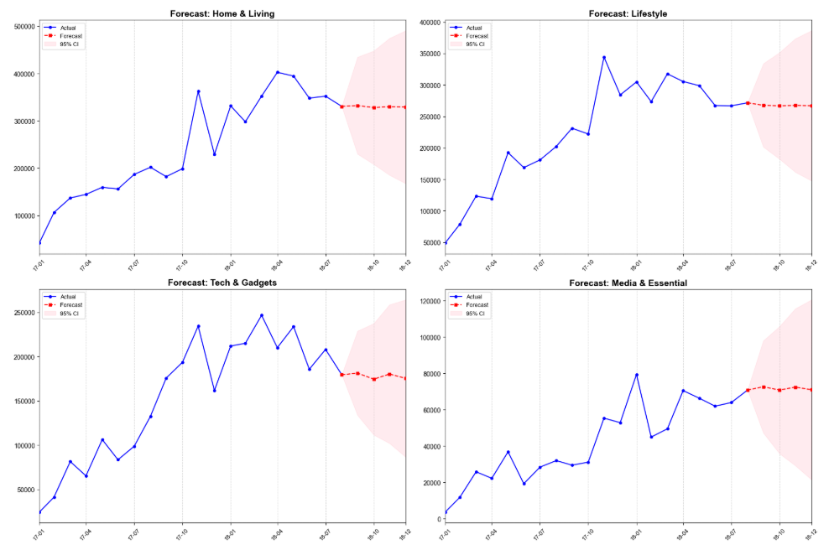
PREDICTIVE ANALYSIS
Appendix: SARIMAX Forecasting Line Chart
Training data (Jan 2017 – Aug 2018)
Forecast Period: Sep 2018 & (S4 Trend)

Slide 17
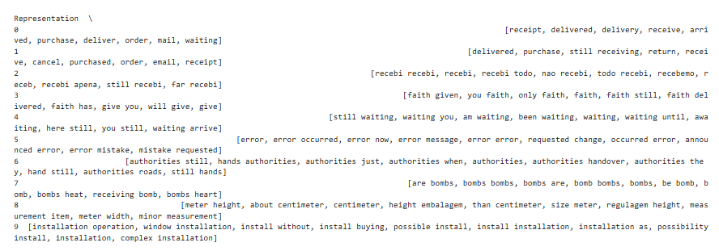
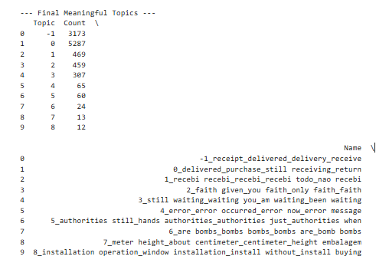
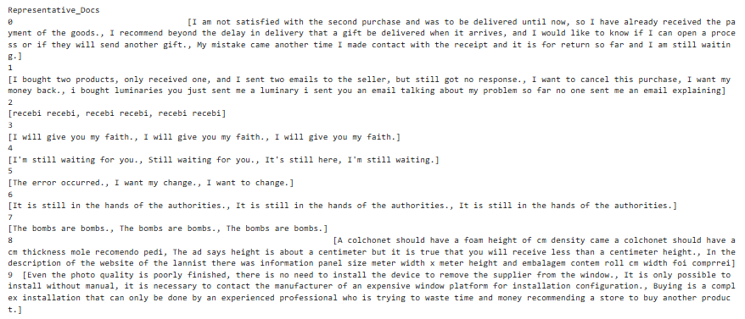
Appendix: NLPBERTopic Overview
Topic 0,3,7,8 are selected
5287 + 307 + 13 + 12 = 5619 reviews

Slide 18
STRATEGIC ACTIONS
Predictive Solutions: Growth Strategy
Strategic Resource Reallocation
Logistics Stress Tests for Media & Essentials
Shift marketing budgets toward Media & Essentials category to secure stable, predictable revenue growth
Conduct intensive stress testing specifically for Media & Essentials sector
Protect largest revenue stream from fulfillment volatility

Slide 19




KEY TAKEAWAYS
Conclusion: From Transactional to Customer-Centric
Strategic Pivot: Transform from a purely transactional platform to a customer-centric market leader.
Address Pain Points
"Action" and "Psychological" pain points in fulfillment and logistics
Double Down on Growth
Resilient growth in Media & Essentials category
Retain High-Value
Implement cluster-specific retention interventions for high-value segments
.

